Slide 1
Weather Web application
BABU BANARASI DAS ENGINEERING COLLEGE
TOPIC :
SUBMITTED TO-
Mr. Alok Kumar Gupta
SUBMITTED BY-
Naveen Kumar Patel
(1905080100056)

Slide 2

INTRODUCTION
This project is about “Weather viewing web application” built using HTML , CSS and JAVASCIPT.
The API provider : www.openweathermap.org

Slide 3
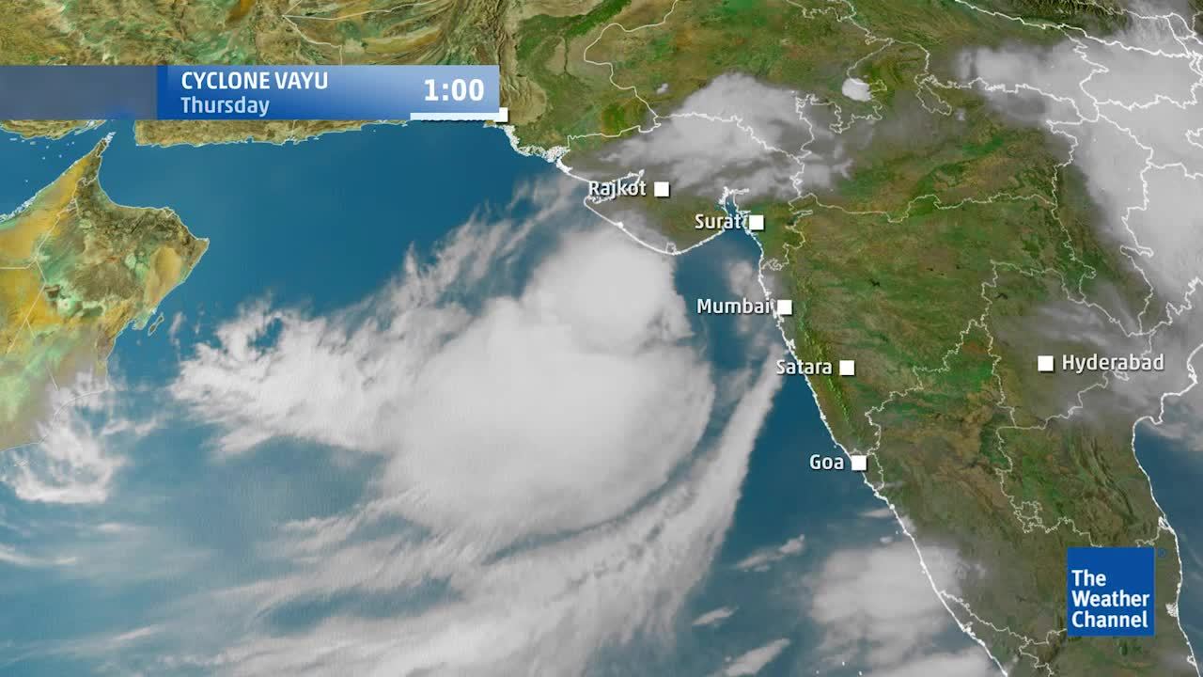
OBJECTIVE
The objective of any weather application is to display the weather accurately.
This app indicates the climate changes over varying time period such as day, week and month

Slide 4



TECHNOLOGY USED
Hypertext Markup Language (HTML)
CSS (Cascading style sheet)
JAVASCRIPT
Application Programming Interface (API)

Slide 5
HTML ,CSS ,JS
HTML ,CSS and Javascript are complementary languages used in the development of web pages and websites.
HTML is mainly used for organization of webpage content.
CSS is used for definition of content presentation style.
Javascript defines how the content interacts and behaves with the user.

Slide 6
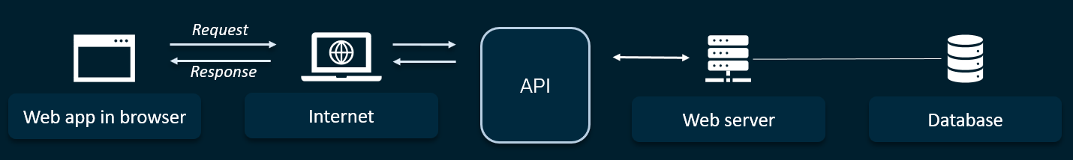
API
API is a set of programming code that enables data transmission between one software product and another. It also contains the terms of this data exchange.

Slide 7
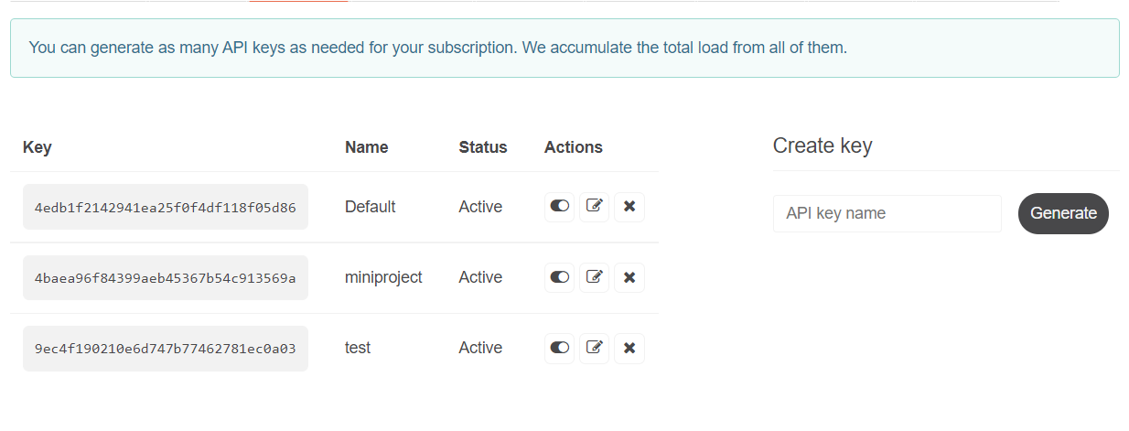
OVERVIEW
API key generation

Slide 8
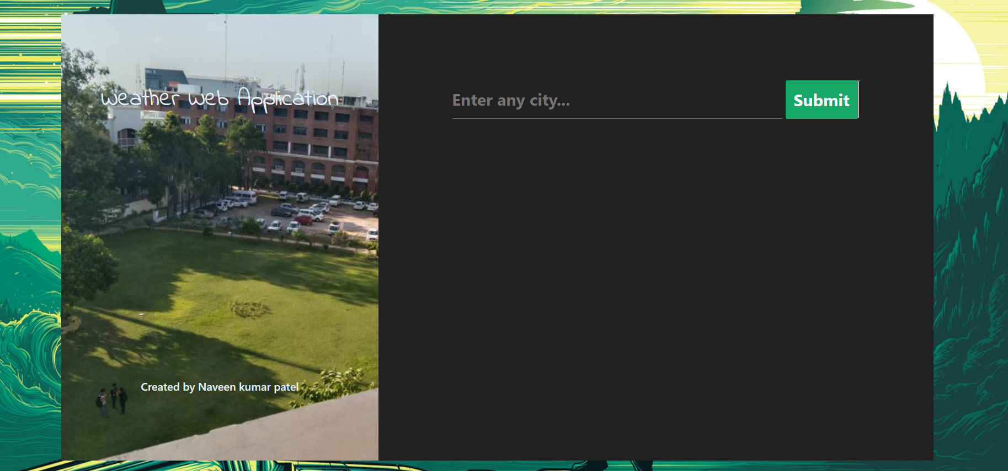
OVERVIEW
Test fig 1.1

Slide 9

OVERVIEW
Test fig 1.2

Slide 10

OVERVIEW
Test fig 1.3

Slide 11
REFERENCE
YOUTUBE
OPENWEATHERMAP.ORG
GEEK FOR GEEKS
W3SCHOOL
GOOGLE

Slide 12
THANKYOU

